Slide 1
OpenChain Project
Understanding How We Build A More Trusted Open Source Supply Chain

Slide 2
Project Overview

Slide 3




Stacking Standards + Solutions
Process Management Standards
Implementation Standards
Methods

Slide 4
Trust Built By Process Management
OpenChain ISO/IEC 5230:2020 International Standard for open source license compliance.
OpenChain ISO/IEC 18974:2023 International Standard for open source security assurance.
High level process standards
Simple, effective and suitable for companies of all sizes in all markets
Openly developed by a vibrant user community and freely available to all

Slide 5
Sister Standards - Processes for Programs
ISO/IEC 5230 (License Compliance)
ISO/IEC 18974 (Security Assurance)
Flexible program size
Covering:
Inbound processes
Internal processes
Outbound processes
Standards about process points
Not about process content

Slide 6


Get Full Overviews Online
ISO/IEC 5230:2020 Open Source License Compliance
ISO/IEC 18974:2023 Open Source Security Assurance

Slide 7
ISO standards are a reputable shorthand in discussions, negotiations and contracts, allowing everything from “expected structure” to “what is a quality program” to be communicated easily. The OpenChain standards are the international baseline for quality in open source license compliance or security assurance programs.

Slide 8

We Have Community Study and Work Groups
Core Work Groups
Education (Autumn 2020~)
Specification (Spring 2016~)
Community Work Groups
Automation (Summer 2019~)
Community Study Groups
AI (January 2024~)
Industry-Specific Work Groups
Automotive (Summer 2019~)
Telecom (Spring 2021~)
Regional User Groups
China (Sept 2019~)
Germany (Jan 2020~)
India (Sept 2019~)
Japan (Dec 2017~)
Korea (Jan 2019~)
Taiwan (Sept 2019~)
UK (June 2020~)

Slide 9
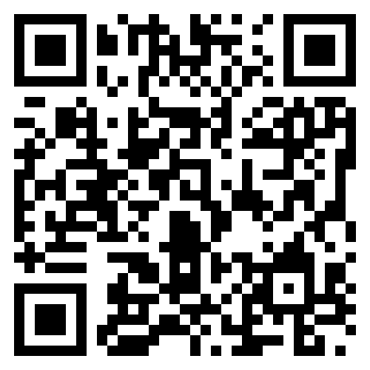
We Have Free Reference Material
The OpenChain Project has extensive reference material:
Reference open source training slides
Policy template material
Supplier education material
Self-certification checklists and questionnaires
+ many, many more documents

Slide 10
Progress Around Our Standards

Slide 11
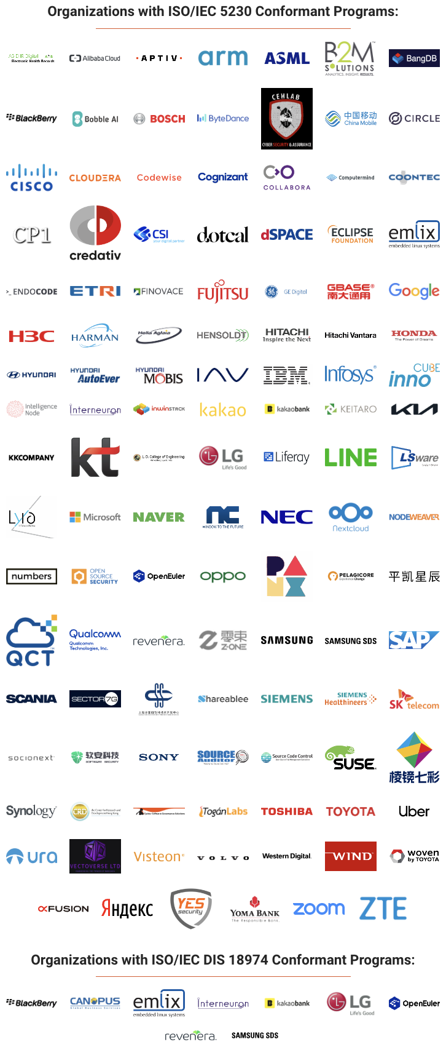





A Continual Heartbeat Of Adoption
OpenChain standards are built, used and supported by all industries
Recent adoption announcements:

Slide 12

Nokia ISO 5230 Self-Certification

Slide 13
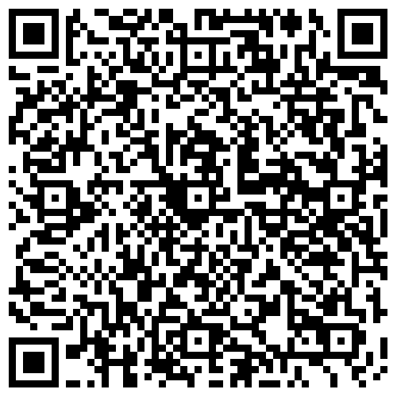
dSpace Adoption of ISO/IEC 5230

Slide 14
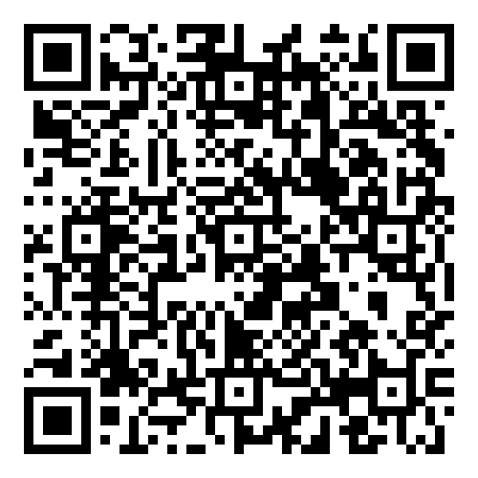
OpenHarmony ISO 5230 Third-Party Certification

Slide 15

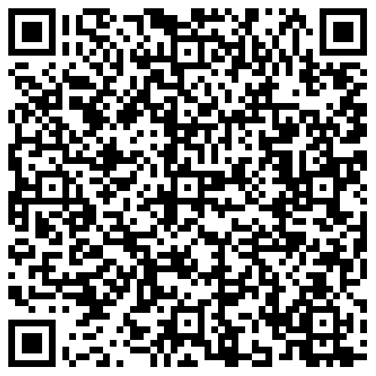
IAV Adopts ISO/IEC 5230 + Case Study Released
News
Case Study

Slide 16

Samsung SDS Adoption of ISO/IEC 18974

Slide 17


A Continual Heartbeat Of Use
Companies announcing re-certification helps to boost perception of continued industry value.
BlackBerry - public announcement in April
SocioNext - public announcement in May
Reminder: ISO standards can be adopted and used by any party, so we only get informed and do PR on a discretionary basis.

Slide 18
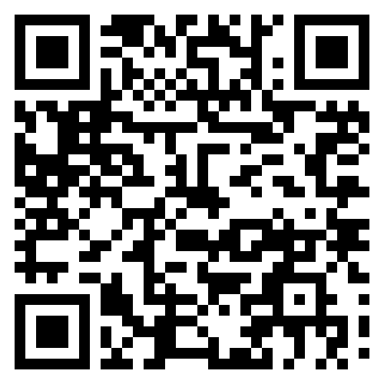
31%
Data Point
of large German companies already use or plan to adopt OpenChain ISO/IEC 5230
Source PwC: https://tinyurl.com/openchain-germany-31

Slide 19
Adoption Methods

Slide 20
How Are OpenChain Standards Adopted?
There are several mechanisms for the adoption of OpenChain Standards
The most common way is self-certification
Another way is third-party certification

Slide 21
Self-Certification – Rationale and Effectiveness
Self-certification to an OpenChain standard (and any other standard) involves an entity reviewing material, deciding that they meet the requirements it describes, and then advertising that fact.
OpenChain provides extensive resources to help with this, such as self-certification checklists.
The OpenChain standards are explicitly designed to work effectively with self-certification because:
They require a company to keep records of how they certified and details of each point (verification materials)
And OpenChain standards are designed for supply chain procurement, with an expectation that customer companies can and will audit supplier company verification materials at the time of their choosing
This has proven extraordinarily effective, and no purposeful attempts to “cheat” have been reported to us since our public launch in 2016.

Slide 22
Third-Party Certification – Rationale
Third-party certification to an OpenChain standard (and any other standard) one legal entity with appropriate permission in the local jurisdiction to certify that another legal entity meets the requirements of the relevant standard.
This is a common approach in regulation-heavy industries such as automotive around standards such as ISO 26262 (functional safety).
Because OpenChain produces ISO standards, it supports and follows the same type of third-party certification processes used by other ISO standards.
Third-party certifiers such as Bureau Veritas and PwC support OpenChain standards.

Slide 23
Support Network

Slide 24
OpenChain Study and Work Groups
Core Work Groups
Education (Autumn 2020~)
Specification (Spring 2016~)
Community Work Groups
Automation (Summer 2019~)
Community Study Groups
AI (January 2024~)
Industry-Specific Work Groups
Automotive (Summer 2019~)
Telecom (Spring 2021~)
Regional User Groups
China (Sept 2019~)
Germany (Jan 2020~)
India (Sept 2019~)
Japan (Dec 2017~)
Korea (Jan 2019~)
Taiwan (Sept 2019~)
UK (June 2020~)

Slide 25

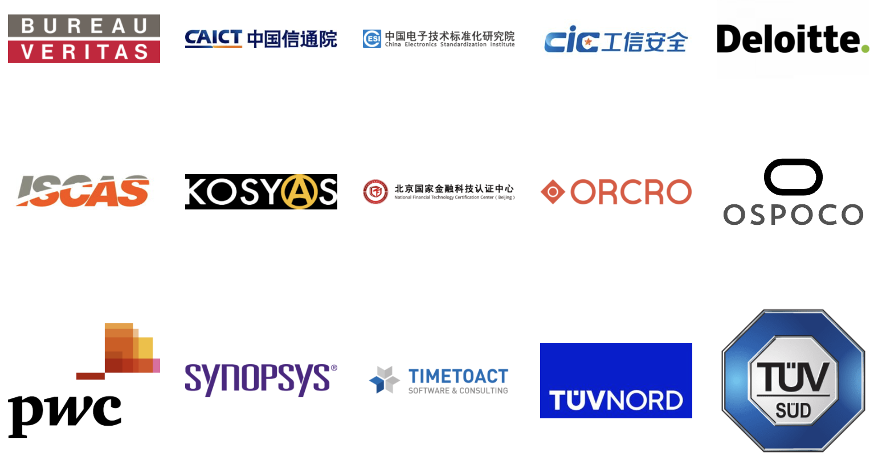
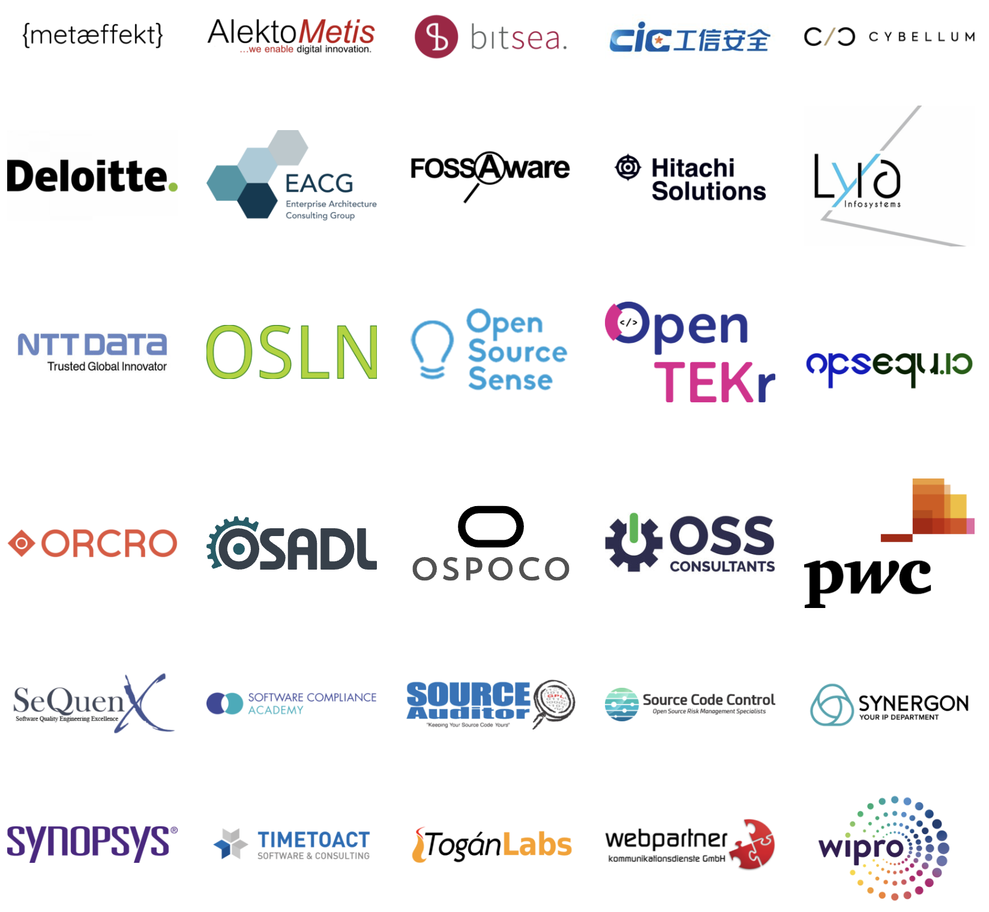
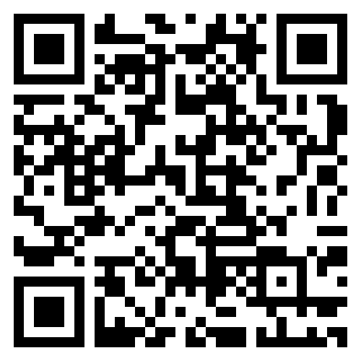
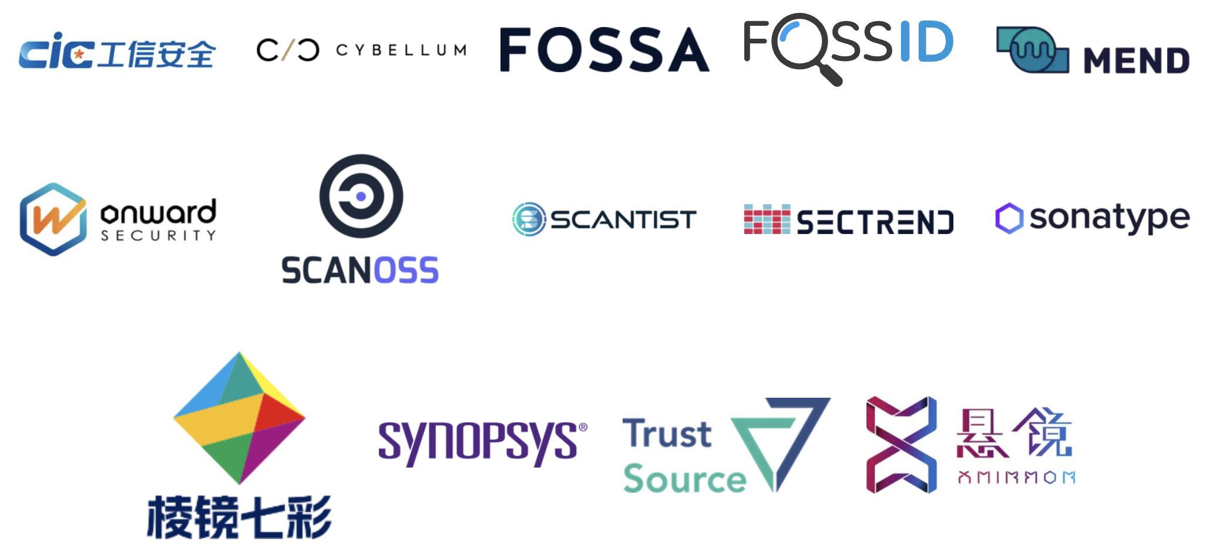
Commercial Support
Legal Providers
Third-Party Certification
Consultancies
Tooling / Automation

Slide 26
Relationship with Other Standards

Slide 27
Wide Compatibility
OpenChain standards are compatible with all compliance standards, security standards and SBOM formats that we are aware of.
In general, OpenChain standards are designed to work with all other standards related to open source process management or solution implementation.
The goal is to be practical and useful for companies of all sizes and in all markets.

Slide 28
Market Evolution

Slide 29
Procurement Negotiations
ISO/IEC 5230 and ISO/IEC 18974 are a simple “ask” for procurement in all industries.
In the 2024/2025 period we expect:
More use of industry standards versus custom approaches for procurement
More use of OpenChain standards

Slide 30
Mergers and Acquisitions
ISO/IEC 5230 and ISO/IEC 18974 are a “floor” to check risk management in M&A.
In the 2024/2025 period we expect:
More use of OpenChain standards for M&A
More case studies around the use of OpenChain standards

Slide 31
Supply Chain Management
ISO/IEC 5230 and ISO/IEC 18974 make it easy for customers to check open source license compliance and security assurance.
In the 2024/2025 period we expect:
More supply chain requests for OpenChain use
Open source maturity models describing OpenChain standards

Slide 32
Supporting Regulation

Slide 33
Addressing US Executive Order / NIST / CISA
OpenChain ISO/IEC 5230 and ISO/IEC 18974 require the use of SBOMs.
They are flexible enough to meet any specific requirements the US develops around SBOM use, structure or format.

Slide 34
Addressing the CRA
OpenChain ISO/IEC 5230 and ISO/IEC 18974 asked for record-keeping before Cyber Resiliency Act (CRA) made it into a requirement.
OpenChain ISO/IEC 5230 and ISO/IEC 18974 require companies to create and archive verification materials around open source license compliance and security assurance.

Slide 35
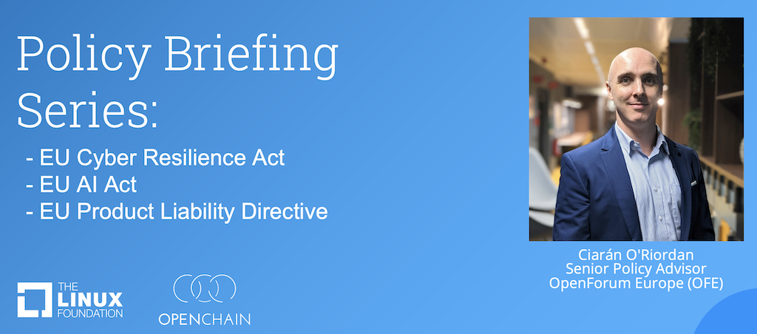
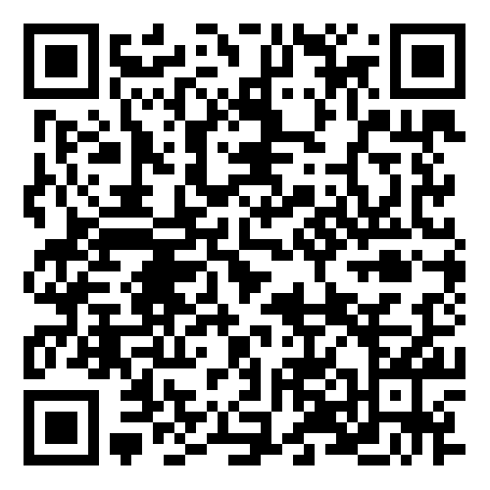
Policy and Regulation Webinar Series:

Slide 36
Reference Material

Slide 37
Existing Reference Material
The OpenChain Project has extensive reference material:
Reference open source training slides
Policy template material
Supplier education material
Self-certification checklists and questionnaires
+ many, many more documents

Slide 38
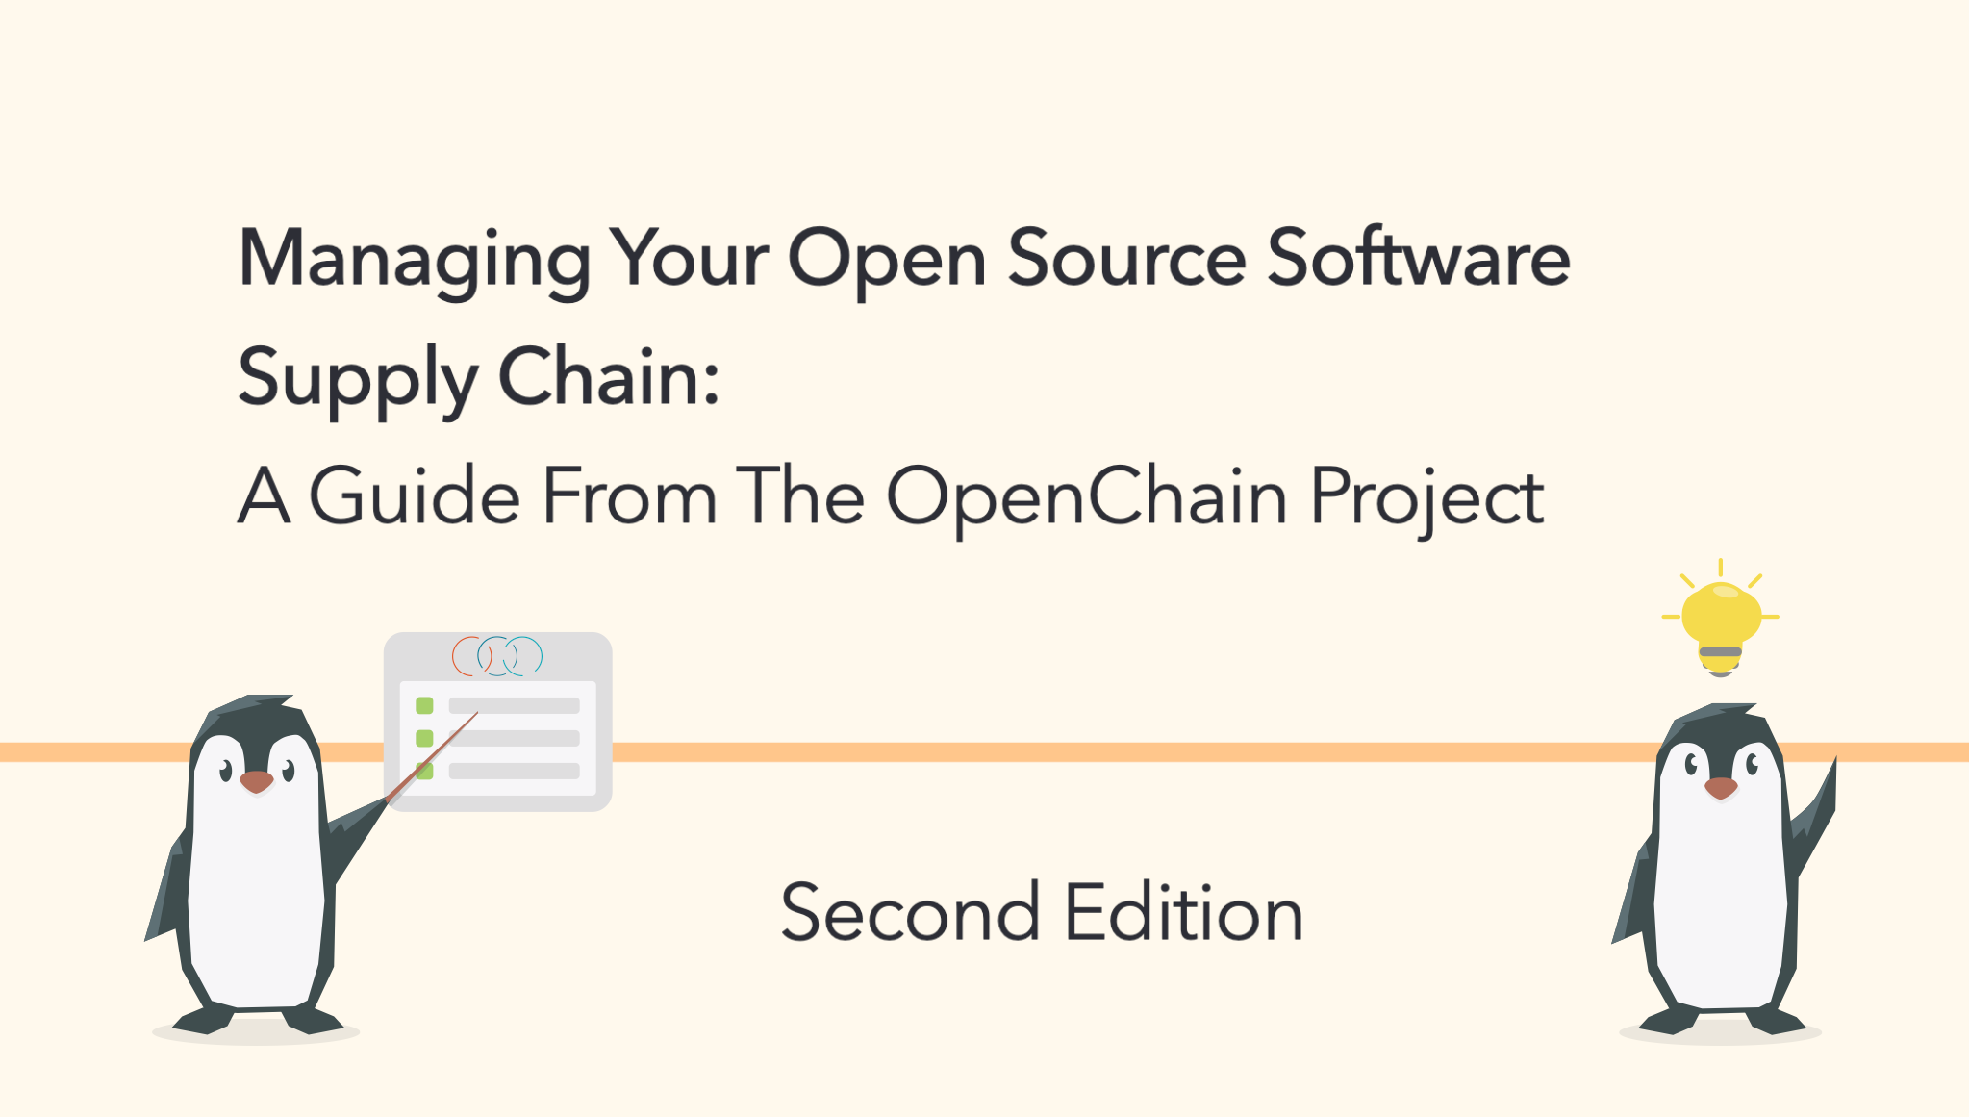
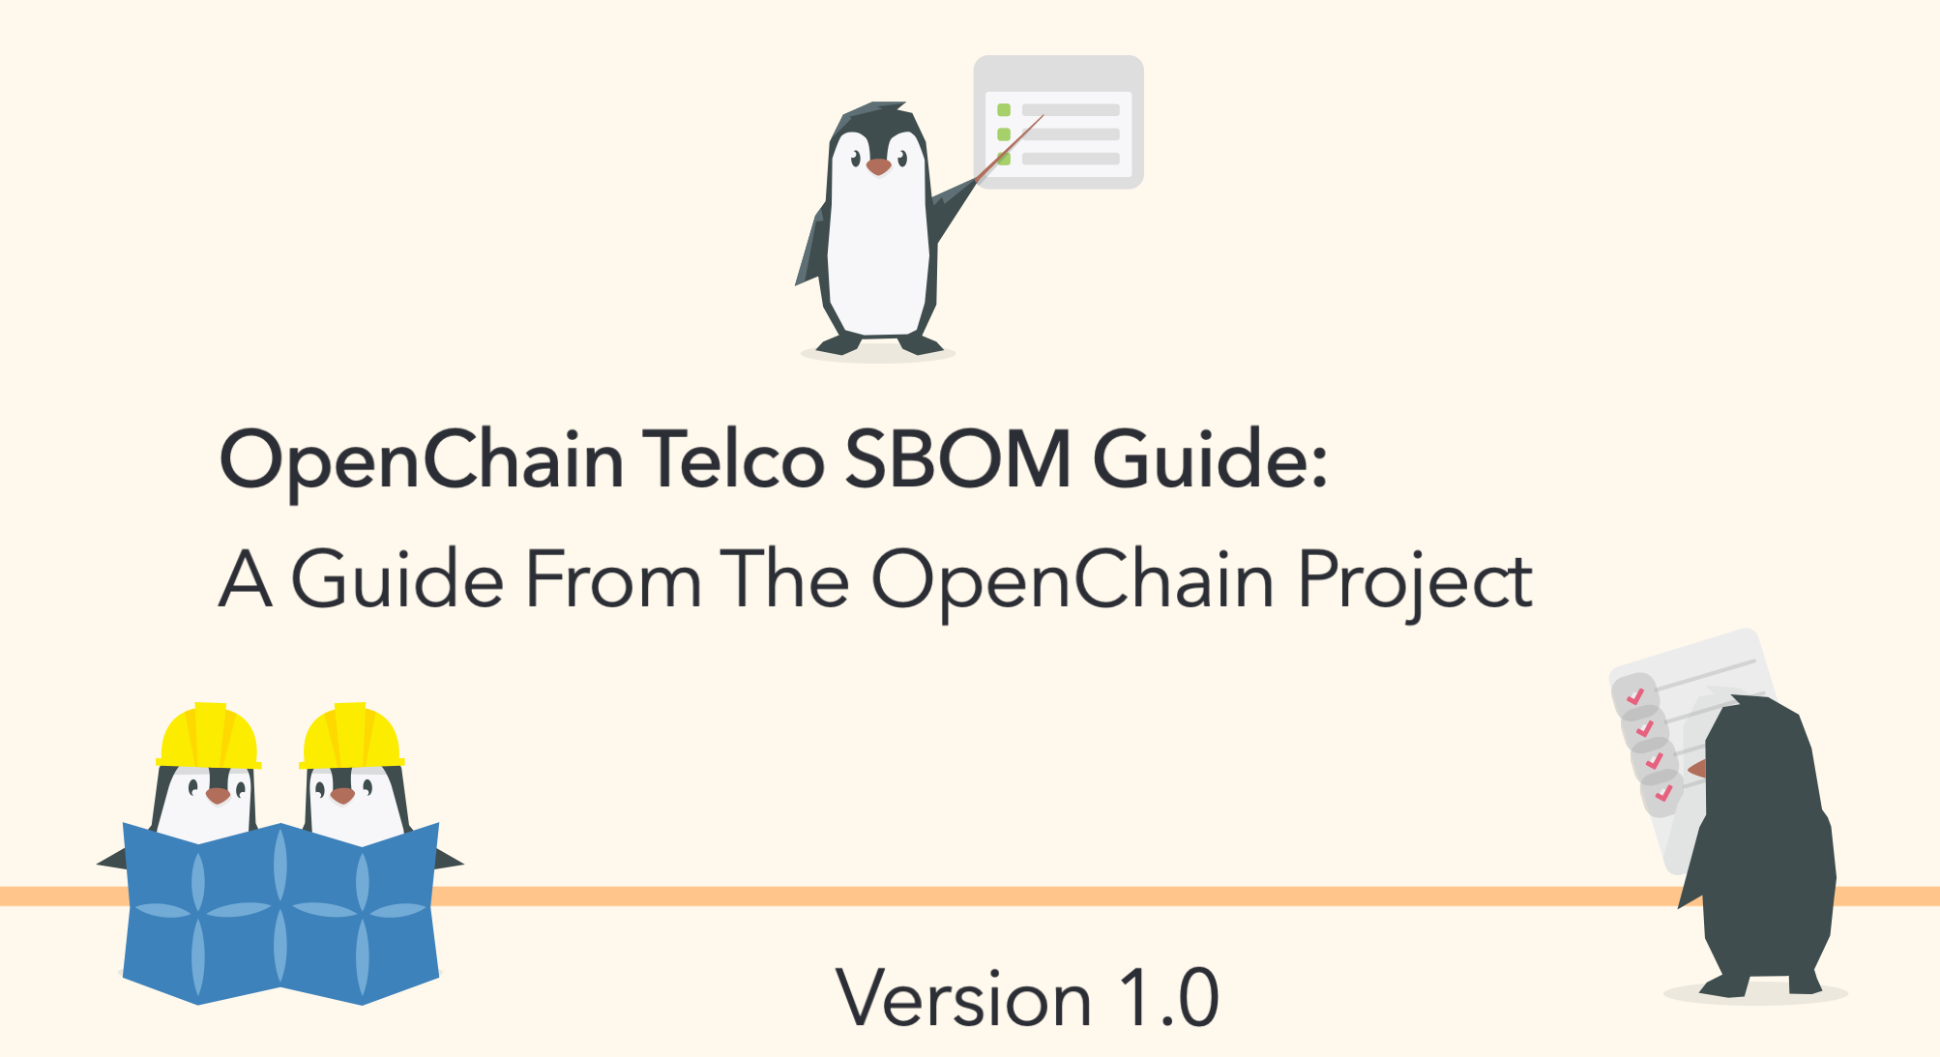


New in July

Slide 39


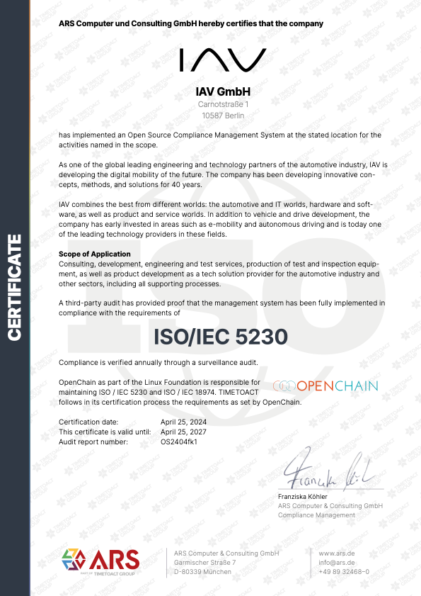


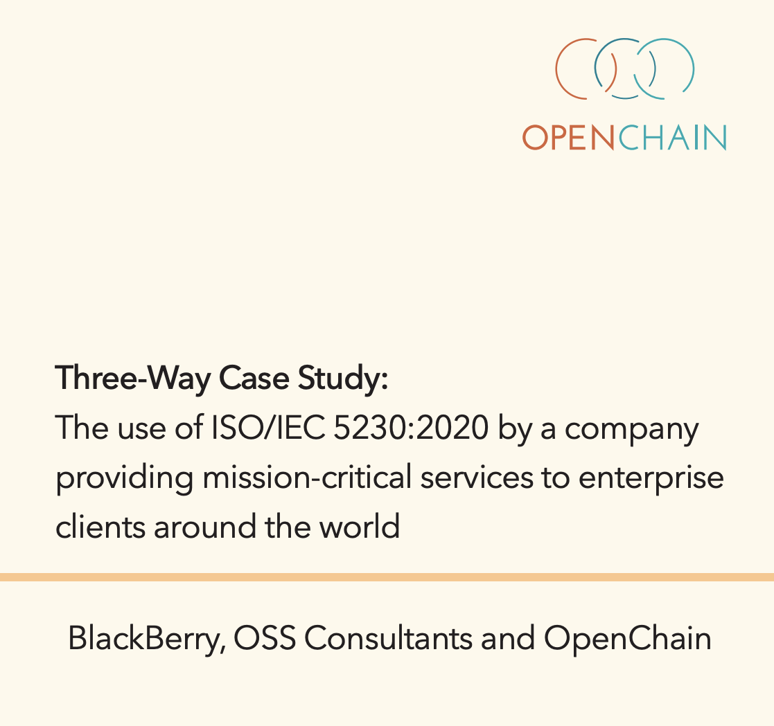
Case Studies

Slide 40
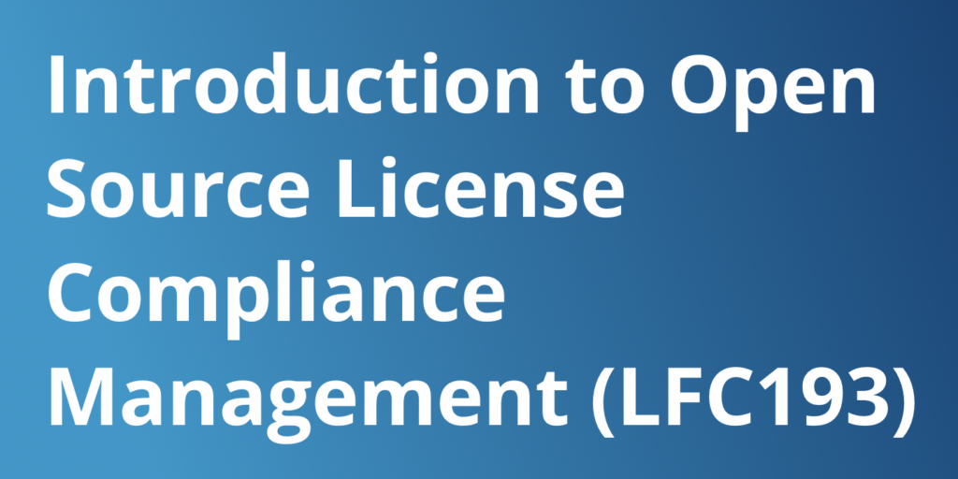
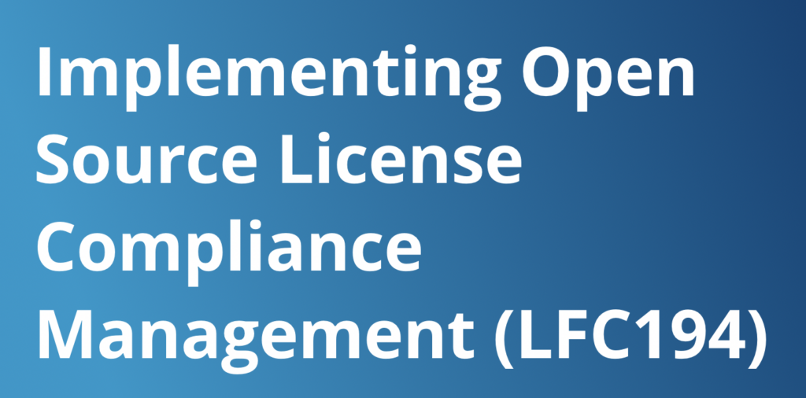
Training Courses

Slide 41

90+
Data Point
Webinars covering all aspects of open source management and governance
https://openchainproject.org/webinars

Slide 42

Reference Material Coming Soon
The OpenChain Project is developing new reference material:
Updated training slides
“Explainers” for different business roles
Maturity model for OpenChain ISO/IEC 5230

Slide 43

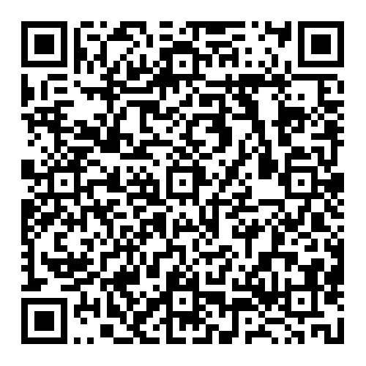
October: CC-0 Maturity Model

Slide 44
Always Evolving

Slide 45


Starting 2024-06-19 ~ Ending 2024-012-19
The OpenChain Project has announced the beginning of its six month Public Comment Period for proposed draft updates to the open source license compliance (ISO/IEC 5230:2020) and open source security assurance (ISO/IEC 18974:2023) specifications.
As per our specification development process outlined in the project FAQ, this Public Comment Period will run for six months, and it will be followed by a three month Freeze Period.

Slide 46






New AI Study Group
Workshops are held once a month discussing AI Compliance in the supply chain co-chaired by Matthew Crawford from Arm and David Marr from Qualcomm. They focus on identifying shared concerns across industries. We are considering a guide about using AI BOM in the trusted supply chain.
April
May
June
July

Slide 47

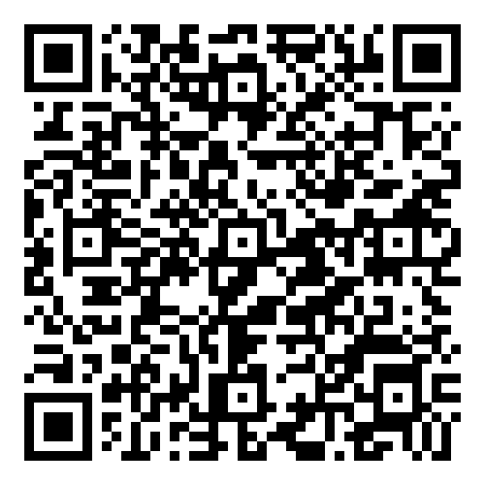
New SBOM Study Group
The OpenChain Project has required Software Bill of Materials for its standards since 2016. Over the years, we have contributed to the field by developing SPDX Lite (a simple SBOM for suppliers) and releasing a guide to define SBOM Quality. In July we launched a new monthly Study Group to bring all our various activities together and answer the question of “how do we use SBOMs in production?” Regular meetings start in September.
July

Slide 48
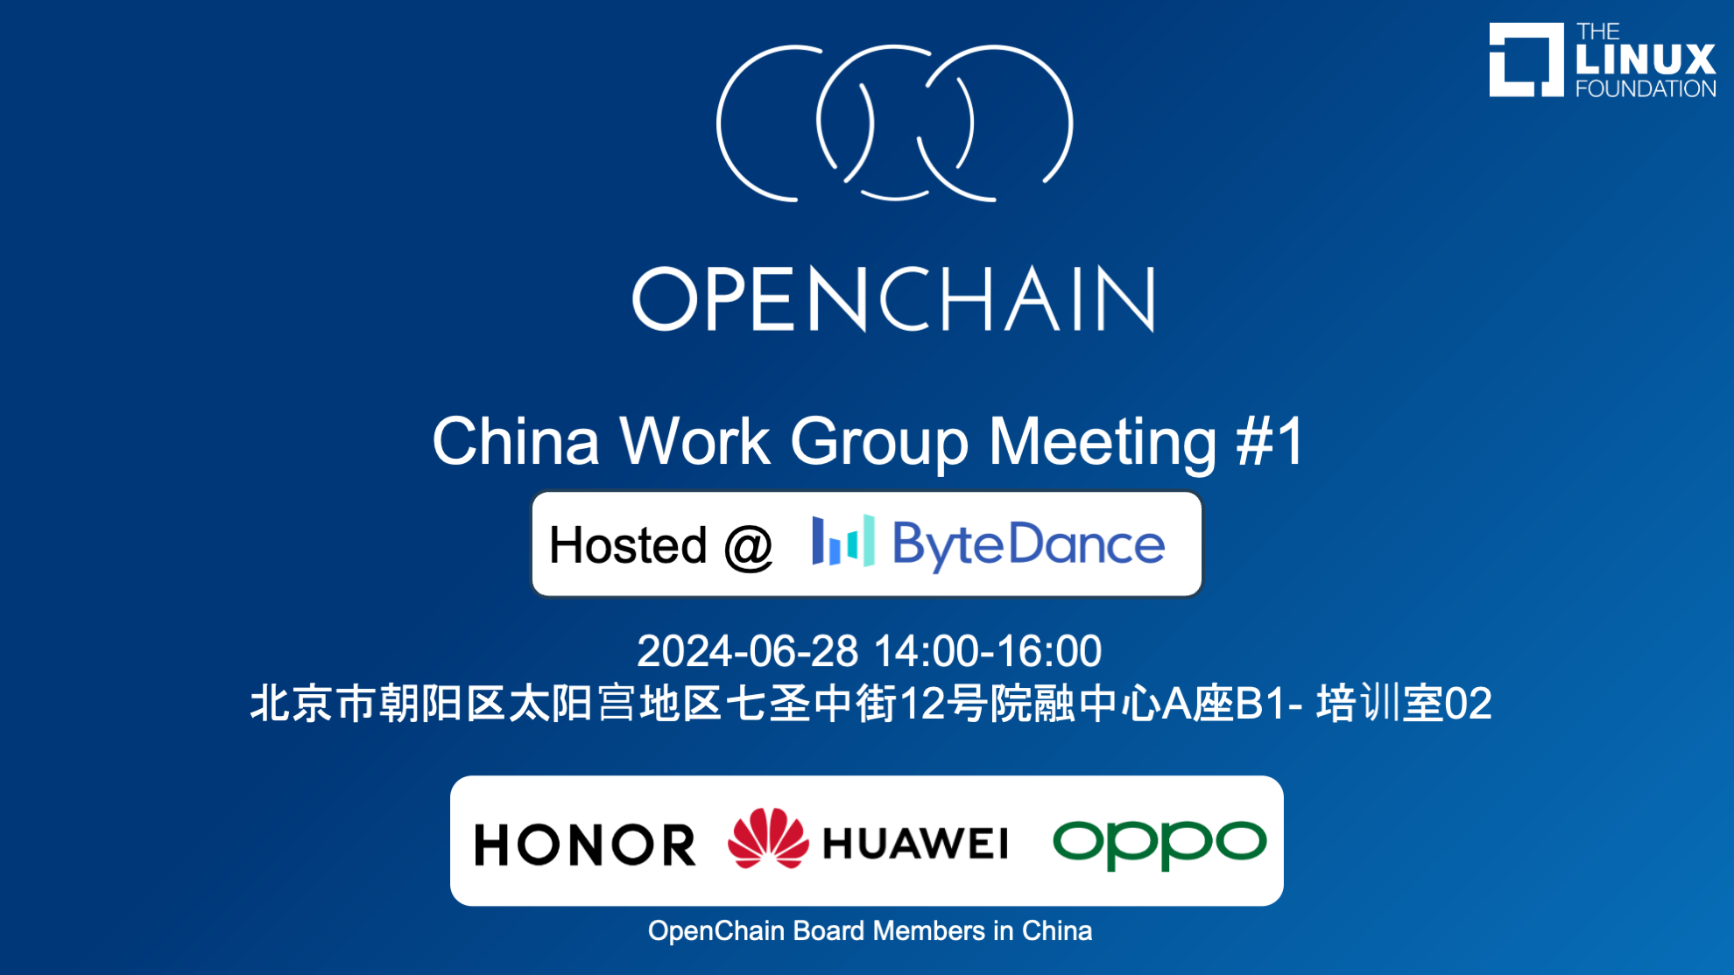
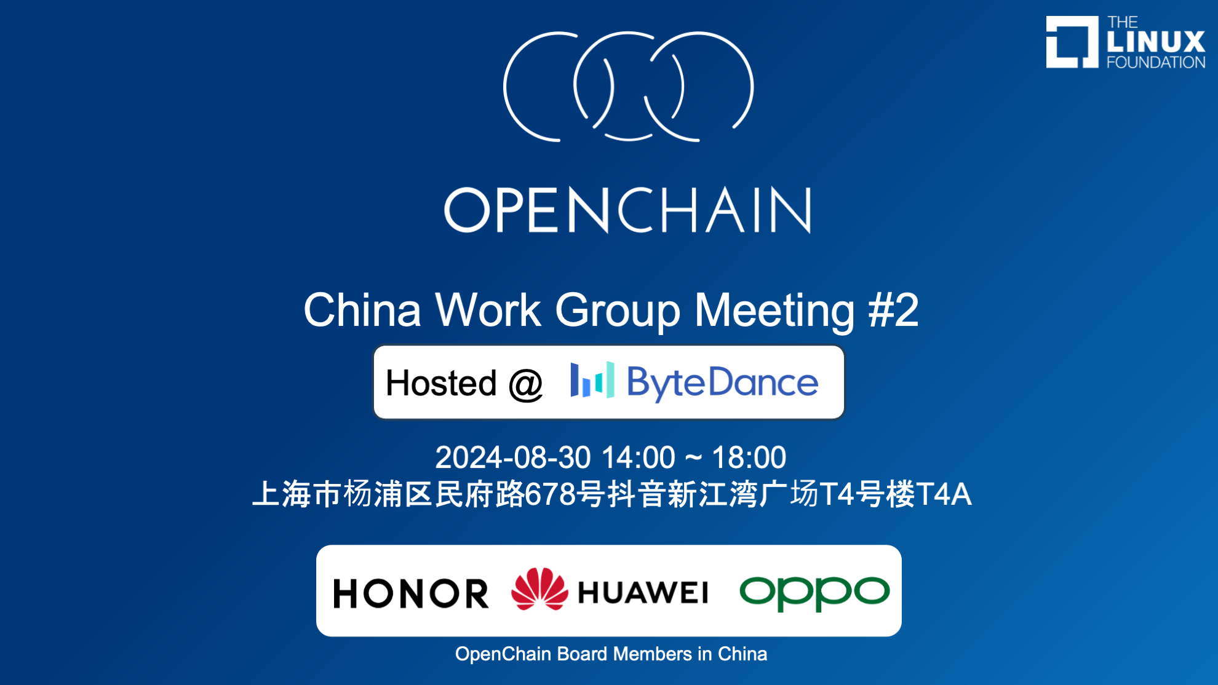
Switched to Regular Meetings in China

Slide 49

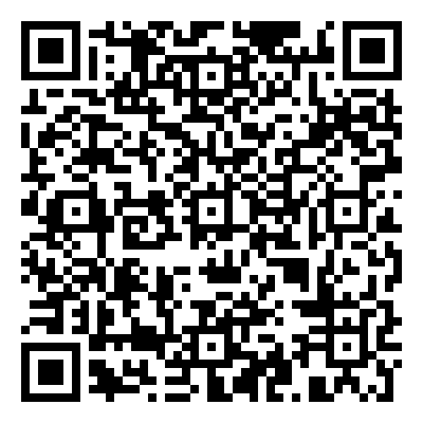
September: Automotive Workshop

Slide 50
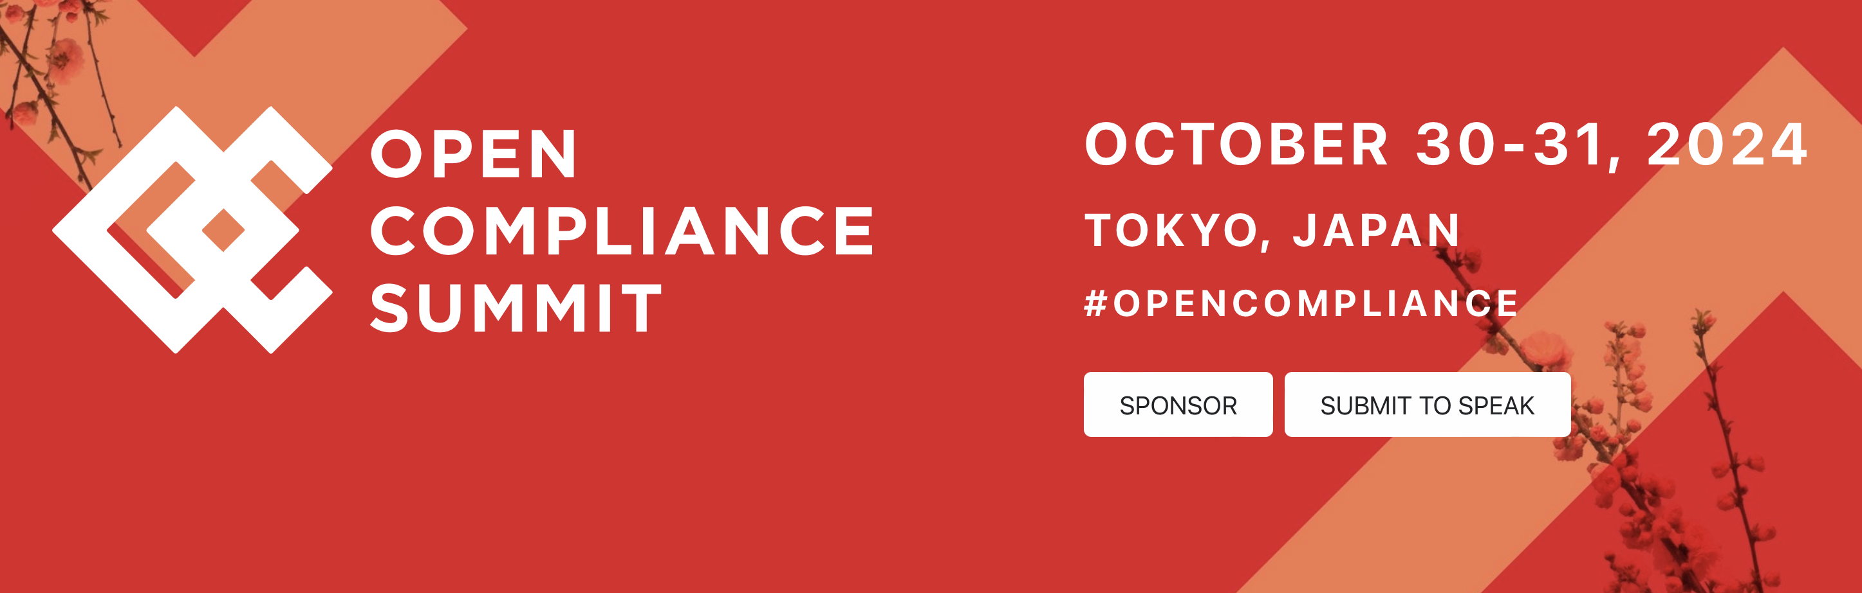

October: Open Compliance Summit

Slide 51
In Conclusion

Slide 52
What Is Happening Right Now?
An increase in the use of formal standards around open source
An increase in the use of OpenChain standards for licensing and security
Improved trust in the supply chain because of this
In 2024/2025 the OpenChain Project expects awareness and capability around open source standards to become critical for companies.

Slide 53
What Is Coming Next For The Market?
There is a steady, inevitable trend:
Open source is becoming more professional
Open source is becoming more accountable
Open source is becoming more sustainable
In 2024/2025 the OpenChain Project expects this trend to bring open source closer to traditional Software Asset Management (SAM).

Slide 54
What Will The OpenChain Project Do?
We will continue to assist in the professionalization of the supply chain, with specific impact in procurement, M&A and supply chain management
We will continue to grow our reference library of material to assist companies adopting and using our standards.
We will also support process management discussions in new domains like AI Compliance

Slide 55
Track All This Work
Our calls are open and publicly listed.
We publish a recording of every meeting not under Chatham House Rule.
We provide access to work groups, special interest groups and local work groups via mailing list.
We also use Slack and WeChat.
All the details can be found on our participation page.

Slide 56

Let’s Talk More
Shane Coughlan
scoughlan@linuxfoundation.org +81 80 4035 8083

